Slide 1
TEACHER’S PERSONAL INFORMATION
Name: Nguyen Thanh Loan
Facebook: Loan Nguyễn Thanh
Mobile number: 0942 255 937
Email: loannguyenthanh1978@gmail.com
Zalo lớp: ……………………

Slide 2
ONLINE ASSIGNMENTS
https://www.helbling-ezone.com
Course: ……………
Course ID: …………….

Slide 3
REVIEW
UNIT 1 & 2

Slide 4
SAYING THE POPULATION STATISTICS BY COUNTRIES
# | Country (or dependency) | Population (2020) | Yearly Change | Net Change | Density (P/Km²) | Land Area (Km²) | Migrants (net) | Fert. Rate | Med. Age | Urban Pop % | World Share
1 | China | 1,439,323,776 | 0.39 % | 5,540,090 | 153 | 9,388,211 | -348,399 | 1.7 | 38 | 61 % | 18.47 %
2 | India | 1,380,004,385 | 0.99 % | 13,586,631 | 464 | 2,973,190 | -532,687 | 2.2 | 28 | 35 % | 17.70 %
3 | United States | 331,002,651 | 0.59 % | 1,937,734 | 36 | 9,147,420 | 954,806 | 1.8 | 38 | 83 % | 4.25 %
4 | Indonesia | 273,523,615 | 1.07 % | 2,898,047 | 151 | 1,811,570 | -98,955 | 2.3 | 30 | 56 % | 3.51 %
5 | Pakistan | 220,892,340 | 2.00 % | 4,327,022 | 287 | 770,880 | -233,379 | 3.6 | 23 | 35 % | 2.83 %
6 | Brazil | 212,559,417 | 0.72 % | 1,509,890 | 25 | 8,358,140 | 21,200 | 1.7 | 33 | 88 % | 2.73 %
7 | Nigeria | 206,139,589 | 2.58 % | 5,175,990 | 226 | 910,770 | -60,000 | 5.4 | 18 | 52 % | 2.64 %
8 | Bangladesh | 164,689,383 | 1.01 % | 1,643,222 | 1,265 | 130,170 | -369,501 | 2.1 | 28 | 39 % | 2.11 %
9 | Russia | 145,934,462 | 0.04 % | 62,206 | 9 | 16,376,870 | 182,456 | 1.8 | 40 | 74 % | 1.87 %
10 | Mexico | 128,932,753 | 1.06 % | 1,357,224 | 66 | 1,943,950 | -60,000 | 2.1 | 29 | 84 % | 1.65

Slide 5
SAYING THE POPULATION STATISTICS BY COUNTRIES
11 | Japan | 126,476,461 | 347 | 364,555 | 71,560 | 1.4 | 48 | 92 % | 1.62 %
12 | Ethiopia | 114,963,588 | 115 | 1,000,000 | 30,000 | 4.3 | 19 | 21 % | 1.47 %
13 | Philippines | 109,581,078 | 368 | 298,170 | -67,152 | 2.6 | 26 | 47 % | 1.41 %
14 | Egypt | 102,334,404 | 103 | 995,450 | -38,033 | 3.3 | 25 | 43 % | 1.31 %
15 | Vietnam | 97,338,579 | 314 | 310,070 | -80,000 | 2.1 | 32 | 38 % | 1.25 %
16 | DR Congo | 89,561,403 | 40 | 2,267,050 | 23,861 | 6.0 | 17 | 46 % | 1.15 %
17 | Turkey | 84,339,067 | 110 | 769,630 | 283,922 | 2.1 | 32 | 76 % | 1.08 %
18 | Iran | 83,992,949 | 52 | 1,628,550 | -55,000 | 2.2 | 32 | 76 % | 1.08 %
19 | Germany | 83,783,942 | 240 | 348,560 | 543,822 | 1.6 | 46 | 76 % | 1.07 %
20 | Thailand | 69,799,978 | 137 | 510,890 | 19,444 | 1.5 | 40 | 51 % | 0.90 %

Slide 6
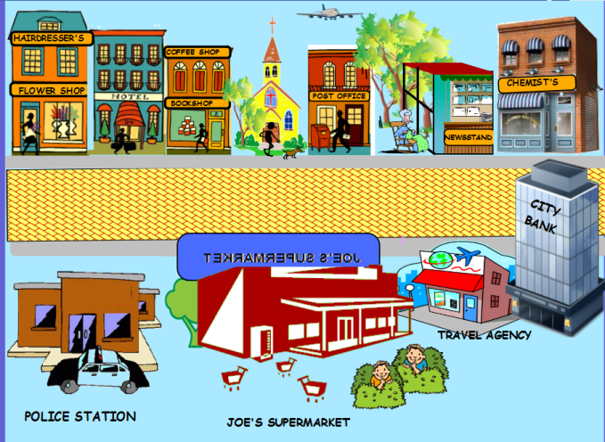
Look at the picture and put the correct preposition into the blank.
The police station is………..Joe’s supermarket.

Slide 7
Look at the picture and put the correct preposition into the blank.
The hotel is………..flower shop and the bookshop.

Slide 8
Look at the picture and put the correct preposition into the blank.
The city bank is………..travel agency.

Slide 9
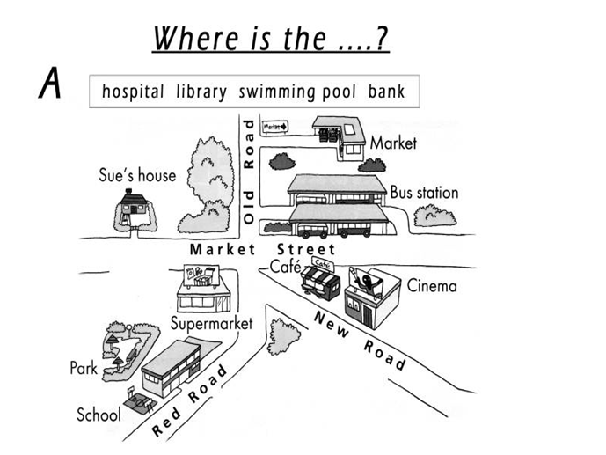
The park is……… school

Slide 10
The cafe is……… the cinema

Slide 11
The market is……… the Old Road

Slide 12
4a
Grammar practice
Do activities 6, 7 (p. 47)

Slide 14
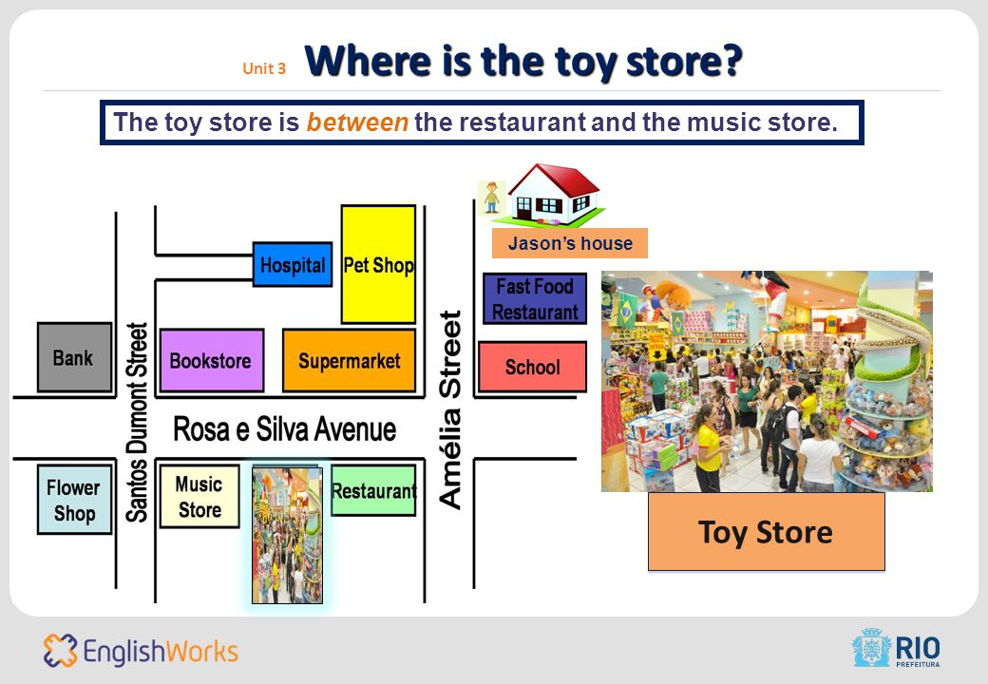

Slide 15
Adjectives of personality
https://www.englishexercises.org/makeagame/viewgame.asp?id=2941

Slide 16
Adjectives of personality
1. Complete the sentences with the appropriate words.
Tim is very ________. People want to be his friends.
a. shy b. friendly c. horrible
2. Joe is ________. He usually makes people laugh.
a. warm b. unfriendly c. funny
3. Karen’s _______. She often helps people whenever she can.
a. kind b. unfriendly c. quiet
4. Pam is very ________ He’s good at everything.
a. intelligent b. horrible c. kind
5. My sister is very beautiful and ________.
a. quiet b. funny c. attractive

Slide 17
Adjectives of personality
1. Complete the sentences with the appropriate words.
6. People who push in front of you in queues are very________.
a. impolite b. serious c. kind
7. Joe is ________ of Linda. Linda is pretty and intelligent, but Zoe isn’t.
a. afraid b. moody c. jealous
8. Karen rarely gets angry with people. She’s usually ________ and understanding.
a. friendly b. jealous c. selfish
9. Pam is very ________ I’m sure you will like her when you meet her.
a. outgoing b. self-confident c. hard-working
10. The teacher usually feels very ________ when her students pass the exam.
a. messy b. proud c. cheerful

Slide 18
CONTENTS
Reading: an adopted child, rooms and furniture
Grammar: “have” in affirmative, negative and questions; possessive’s, “there is”, “there are” in affirmative, negative and questions.
Function: talking about your family; talking about furniture in your house. .

Slide 19
READING
An adopted child

Slide 20
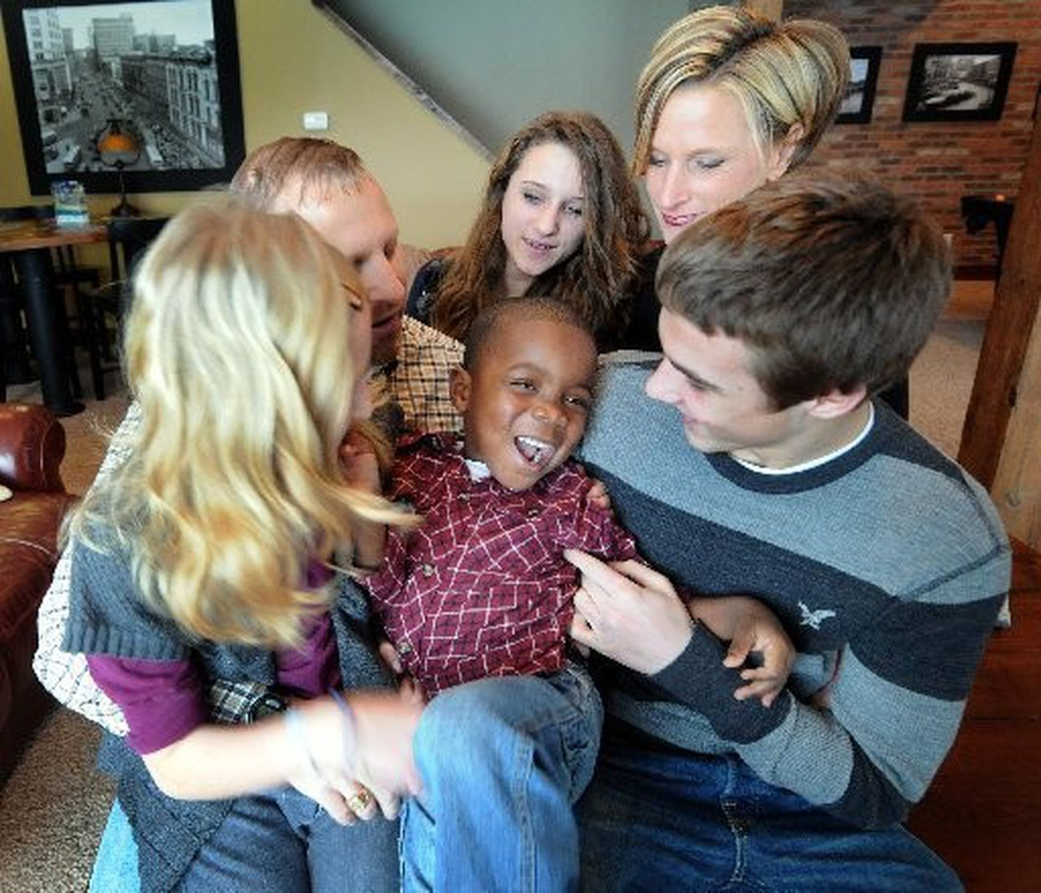
VOCABULARY
adopted
/əˈdɒptɪd/
an adopted child has legally become part of a family that is not the one in which he or she was born.
Ex: Grady is Mark and Julie Augustan’ adopted son.

Slide 21
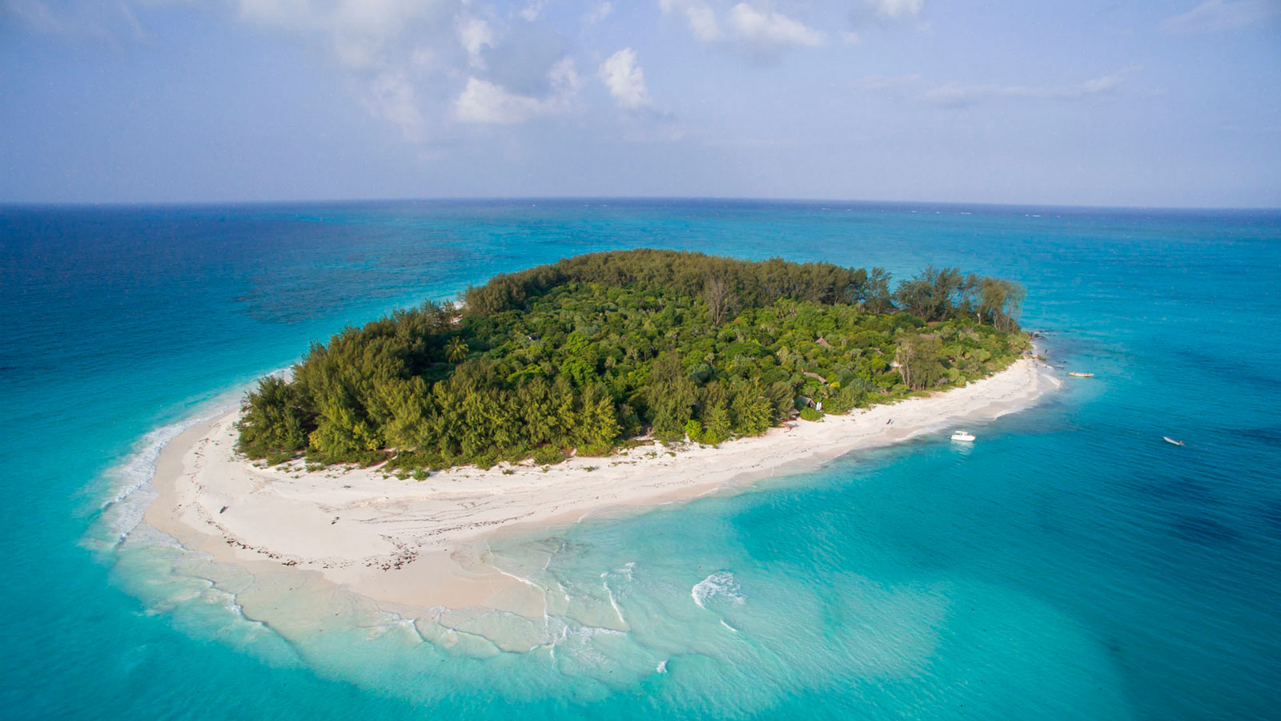
VOCABULARY
island
/ˈaɪlənd/
a piece of land that is completely surrounded by water.
Ex: We spent a week on the Greek island of Kos..

Slide 22
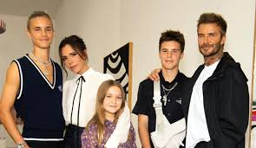
VOCABULARY
biological child
/ˌbaɪəˈlɒdʒɪkl/
Ex: Brooklyn Joseph is David Beckham’s biological son.

Slide 23
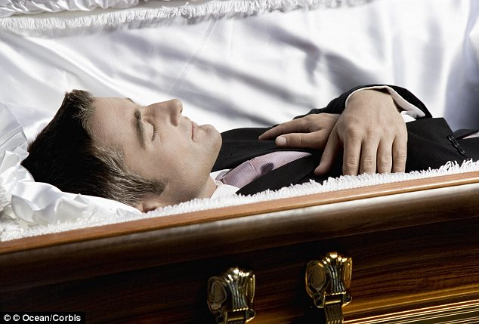
VOCABULARY
dead
/ded/
no longer alive
Ex: My brother's dead. He died in 2017.

Slide 24
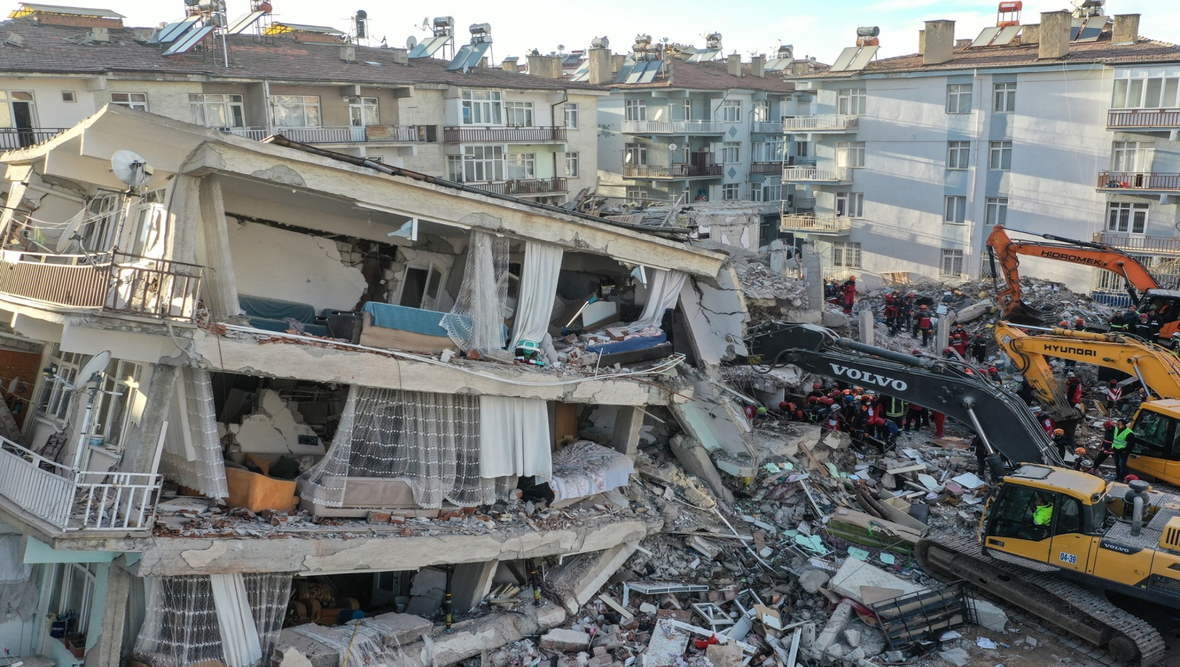
VOCABULARY
earthquake
/ˈɜːθkweɪk/
a sudden, violent shaking of the earth’s surface
Ex: Much of the town was destroyed in the earthquake.

Slide 25
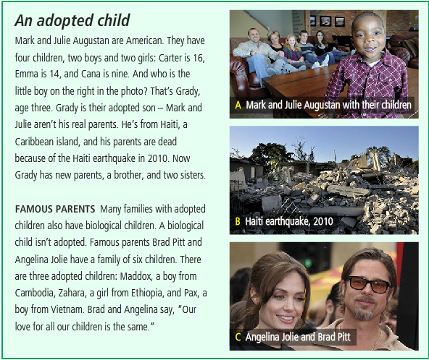
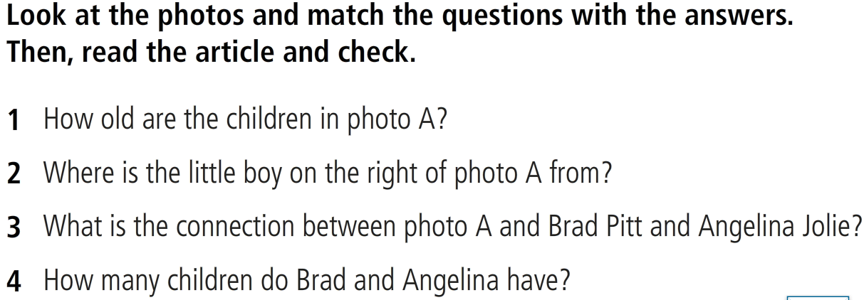
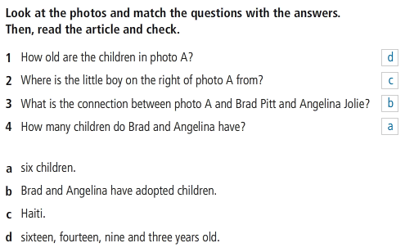
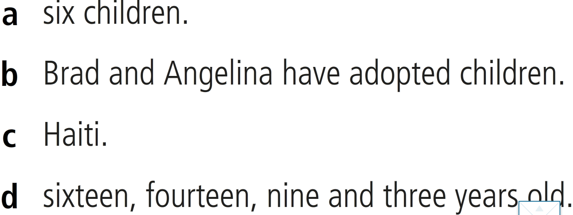
READING

Slide 26
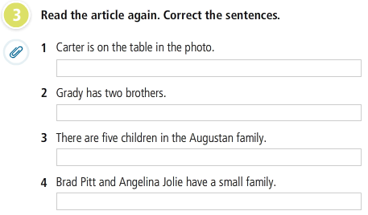
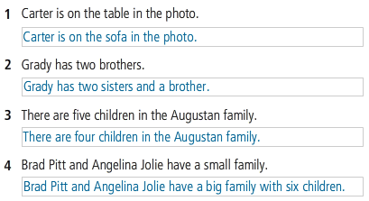
READING

Slide 27
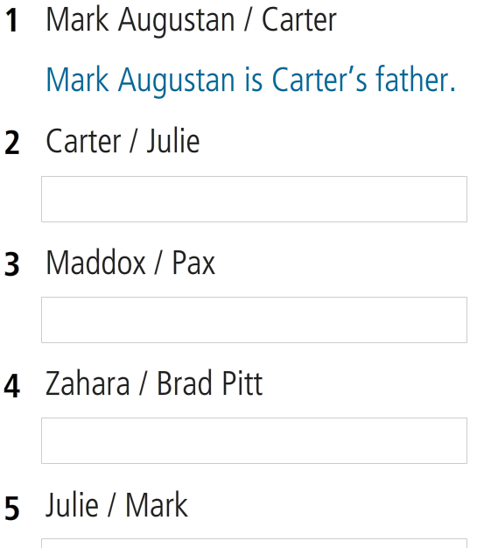
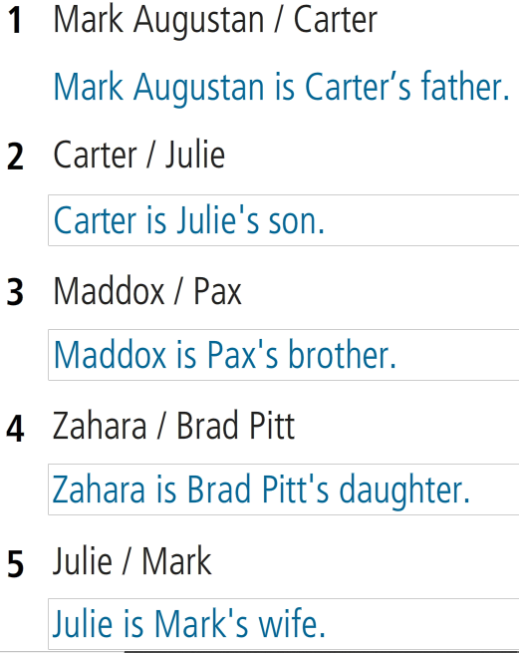
Write sentences about these people.
Use the possessive’s

Slide 28
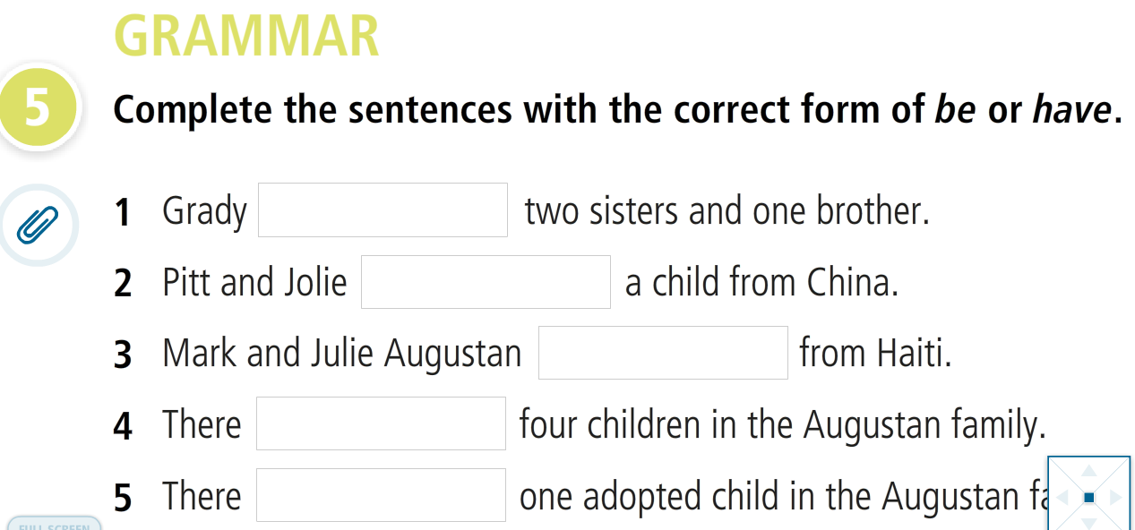
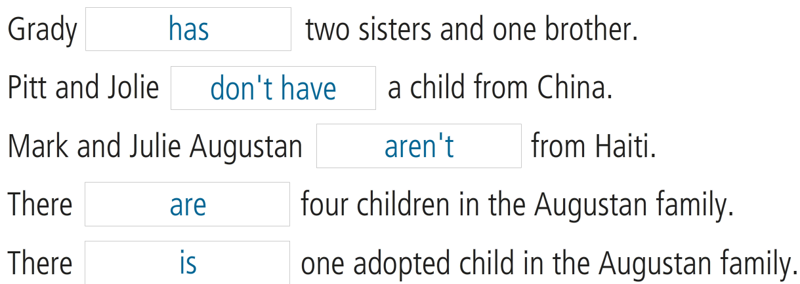

Slide 29
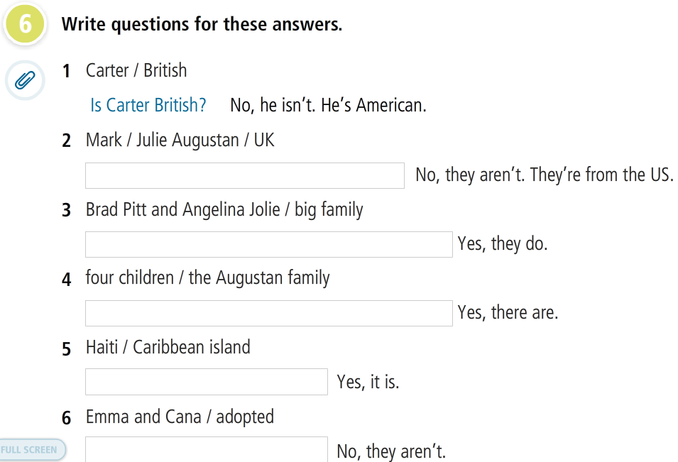
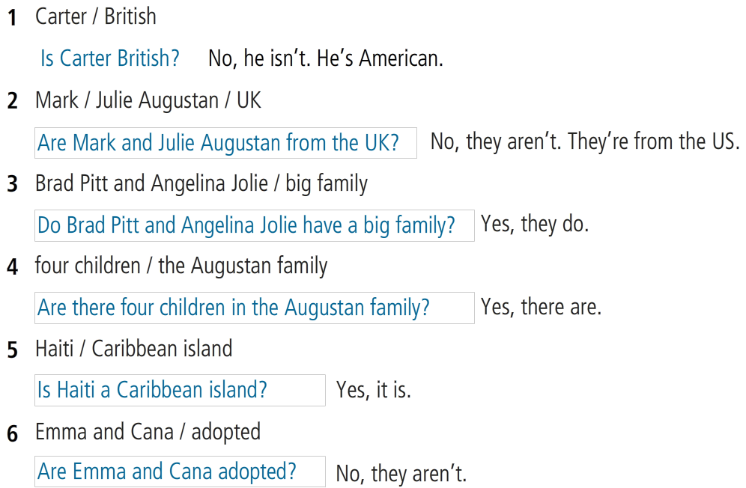
GRAMMAR

Slide 30
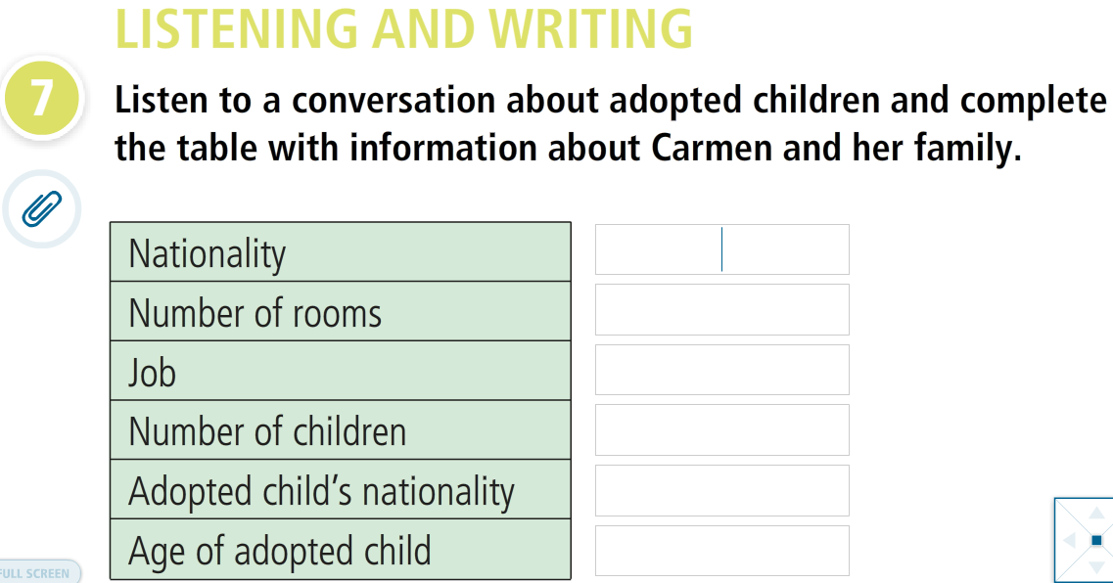

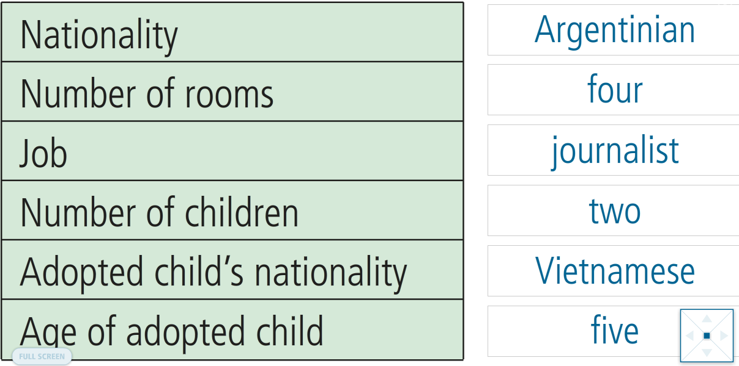

Slide 31
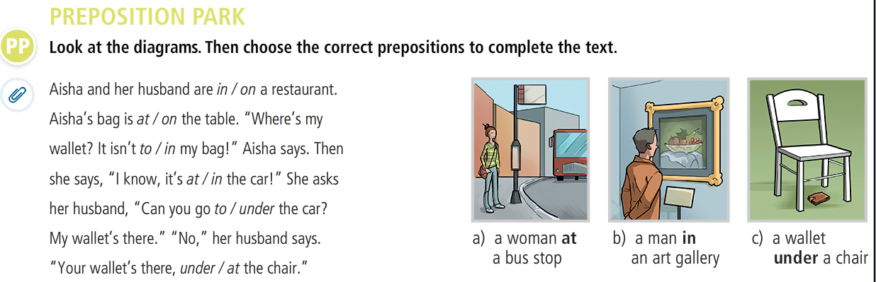
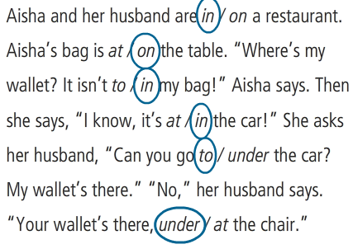

Slide 32
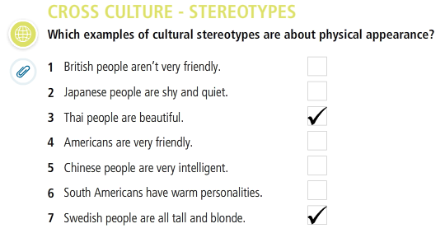
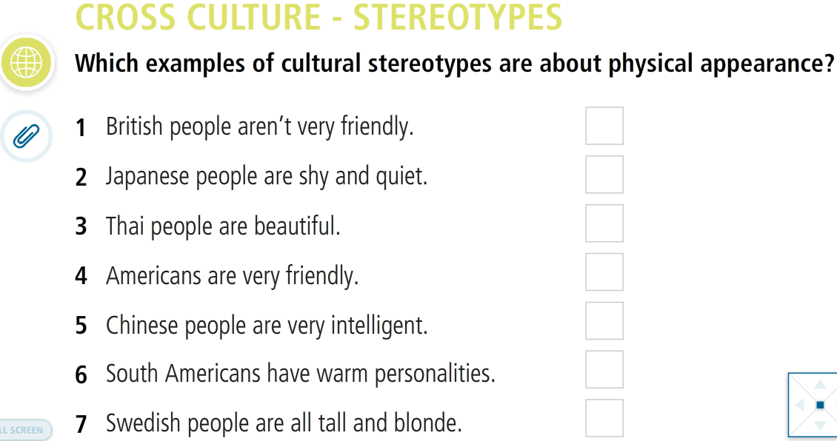

Slide 33
The end!

